Slide 1
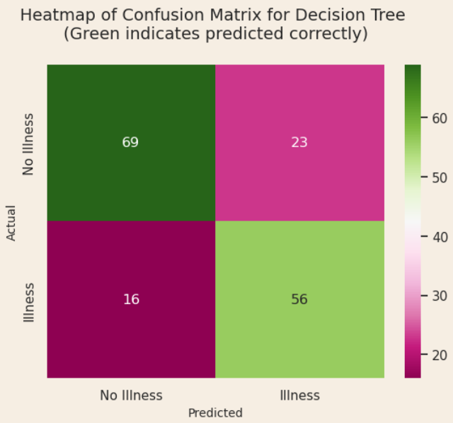
Respiratory Illness Prediction
Problem: Predict with more than 60% accuracy who may be affected by a respiratory illness.
Solution: Use supervised learning classification and train models to make predictions based on data.
Findings: Two models were chosen: Decision Tree and Logistic Regression. Decision Tree provided an accuracy of 76%. Logistic Regression provided an accuracy of 74%.
Limitations: The dataset contained 3.8 times more observations on male patients than female patients.
Random Forest, Neural Network, and Gradient Boost models were not tested. It is possible those models may give better results.
Conclusion: While both models exceeded 60%, the Decision Tree model provided the highest at 76%.
The Decision tree model has an accuracy of %76. The model predicted 125 (69 + 56) of 164 correctly.

